Slide 1
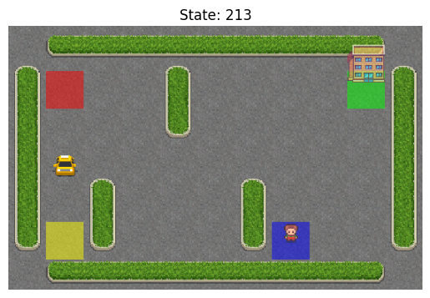

Taxi Environment
-OpenAI Gym
Name : Meghana Maganti
Roll Number : S20210010132

Slide 2
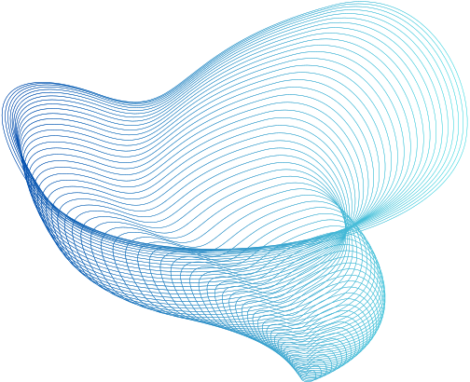
Markov Decision Process(MDP) Components
States (S):
500 discrete states represented as (taxi_row, taxi_col, passenger_location, destination)
Passenger locations :
{0: R(ed) , 1: G(reen), 2: Y(ellow), 3: B(lue), 4: in taxi}
Destinations :
{0: R(ed) , 1: G(reen), 2: Y(ellow), 3: B(lue)}

Slide 3
Markov Decision Process(MDP) Components
Actions (A):
6 discrete deterministic actions
{0: move south, 1: move north, 2: move east, 3: move west, 4: pickup passenger, 5: drop off passenger}.
Transition Function (P):
Deterministic transitions with p=1.0
Some actions may have no effect on the state.

Slide 4
Markov Decision Process(MDP) Components
Reward Function (R):
-1 per step unless another reward is triggered.
+20 for delivering the passenger.
-10 for illegal pickup or drop-off actions.
Discount Factor (γ):
Typically set to 0.99

Slide 5

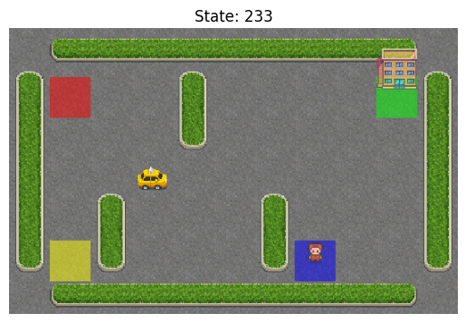
Taxi Map and RGB Representation
+--------------------+
| R : | : : G |
| : | : : |
| : : : : |
| | : | : |
| Y | : | B : |
+--------------------+
t.

Slide 6
State and Observation Space
State Space:
500 discrete states, with 404 reachable during an episode
Observation Space:
States represented as integers encoding
(taxi_row, taxi_col, passenger_location, destination)
Example:
The state (2,3,1,0) can be encoded as an integer and decoded back

Slide 7
Example Trajectory
An example trajectory includes a sequence of states, actions, and rewards:
[state, action, reward, done, next_state]
Example:
[ (0, 0, 2, 1), 0, -1, False, (1, 0, 2, 1) ]

Slide 8
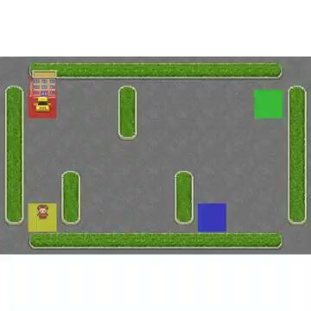
Simulation by following random policy

Slide 9
Conclusion and Code
Code File : Colab File
Simulation result:
Using a random policy led to 200 moves with a total return of approximately -308.03.
Key takeaway:
Random policies are inefficient; the agent's performance can be significantly improved through policy optimization techniques.
Future work:
Focus on developing and implementing optimized policies to achieve more efficient navigation and better rewards in the environment.

Slide 10
THANK YOU

